Slide 1

Mini Project: Vikings
Harmandeep & Aitor & Suzana

Slide 2
Introduction
Vikings and Saxons are in War!!
Core goal: model a war simulation game using Object-Oriented Programming
Usage of Class, Attributes, methods and instances.
Defining Inheritance and methods overwriting.
Randomness is used to simulate unpredictable battle outcome.

Slide 3
2. Project Setup & Core Concepts
Project Setup
Core Concepts
Main file: vikingsClasses.py
Test files:
1-testsSoldier.py
2-testsVikings.py
3-testsSaxons.py
4-testsWar.py
Only vikingsClasses.py is modified
Classes and Objects
Inheritance
Method Overriding
Polymorphism
Lists and Loops
Random selection
Testing & Debugging

Slide 4
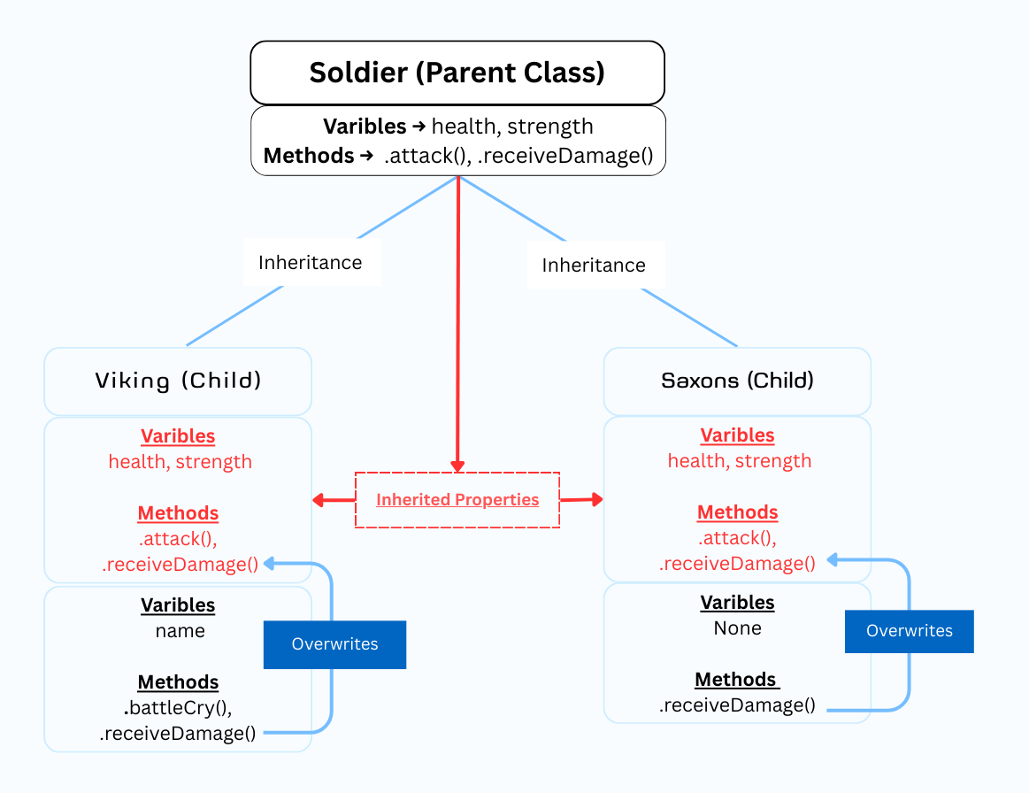
3. Class Structure
Soldier (Base/Parent class)
health, strength
Viking (inherits Soldier)
name, battleCry
Saxon (inherits Soldier)
no name, weaker fighter

Slide 5
4. How the game works?
Manage the War
Simulate the War
War Class:
Manages interactions between the created classes
Uses randomness
Uses loops create armies and run battle rounds
Cheks conditions: health, army size, end of war
Multiple Vikings and Saxons exist at the same time
One War instance controls everything
Loop to determine rounds of battle
Conditionals to check who dies and who wins
Random module, adds unpredictability

Slide 6
5. Challenges Faced
Understanding Inheritance
How Viking & Saxon inherit from Soldier Class.
When to use super(). __int__()
Understanding War Control Mechanism
How to use "Random" Library to select random Warrior.
Then identify which "receiveDamage()" method will be use.
Understanding test requirements
Using "return" to output formatted string instead of using print() function.
Correctly removing dead soldiers from the appropriate army.
Debugging
Debug logic errors using test failure messages.
Example:
test expects "A Saxon has received 30 points of damage"
Code ouptut: "A Saxon has received 30 point of damage"

Slide 7
6. Conclusion
OOP
Clear Game Structure
CLASSES
Share Atributes: health, strength
INSTANCE
Class child : each new viking or saxon
Class WAR
Controller: Manages game play Logic
Shared behavior: Attack, Receive damage
random, loops, and conditionals
Supports
- random not act alone is using inside methods of War Class, operates on instances
Notes:
Loops create armies and run battle rounds
- Conditionals check:
- health
- army size
- win/lose state

Slide 8
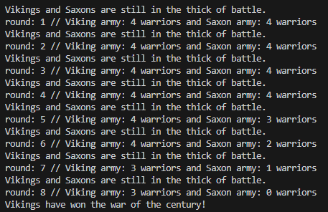
Who won the war?

Slide 9
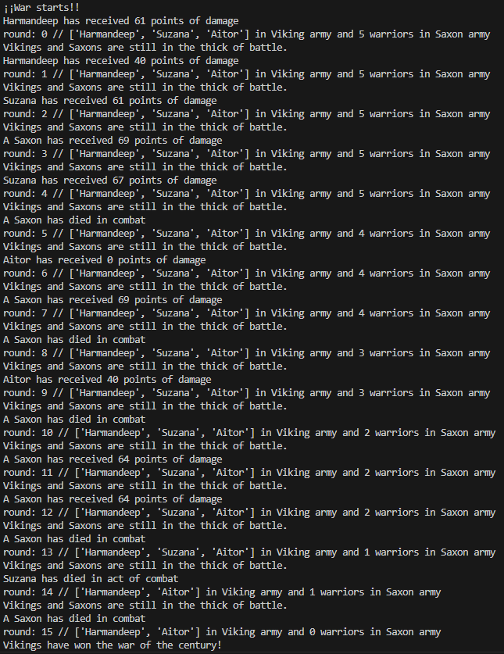

Simulation

Slide 10


Winners

